Slide 1
Layouts, RenderBody, RenderSection and RenderPage in ASP.NET MVC
Layouts are used to maintain a consistent look and feel across multiple views within ASP.NET MVC application.
An application may contain common parts in the UI which remains the same throughout the application such as the logo, header, left navigation bar, right bar or footer section. ASP.NET MVC introduced a Layout view which contains these common UI parts, so that we don't have to write the same code in every page. The layout view is same as the master page of the ASP.NET webform application.
an application UI may contain Header, Left menu bar, right bar and footer section that remains same in every page and only the centre section changes dynamically as shown below.

Slide 2
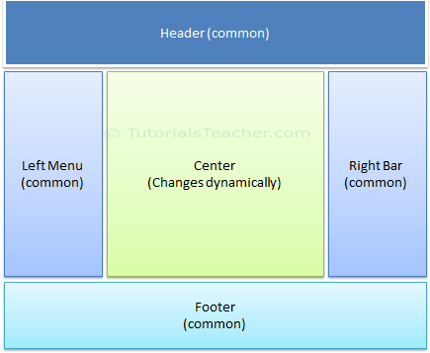
Layouts, RenderBody, RenderSection and RenderPage in ASP.NET MVC

Slide 3
Layouts, RenderBody, RenderSection and RenderPage in ASP.NET MVC
Rendering Methods:
ASP.NET MVC layout view renders child views using the following methods
RenderBody()
Renders the portion of the child view that is not within a named section. Layout view must include RenderBody() method.
@RenderBody()
RenderSection(string name)
Renders a content of named section and specifies whether the section is required. RenderSection() is optional in Layout view.
@RenderSection("header")
@RenderSection("header",false)
RenderPage()
RenderPage method also exists in the Layout page to render other page exists in your application. A layout page can have multiple RenderPage method.
@RenderPage("~/Views/Shared/_Header.cshtml")

Slide 4
Layouts, RenderBody, RenderSection and RenderPage in ASP.NET MVC
RenderBody() | RenderSection()
RenderBody must be present in the layout view. | RenderSection method is optional.
RenderBody renders all the content of child view which is not wrapped in named section. | RenderSection renders only a part child view that is wrapped under named section.
Multiple RenderBody() method is NOT allowed in a single layout view. | Multiple RenderSection() method is allowed in a single layout view.
RenderBody() method does not include any parameter. | RenderSection() method includes boolean parameter "required" which makes the section optional or mandatory. If required parameter is true then the child view must contain the section.

Slide 5
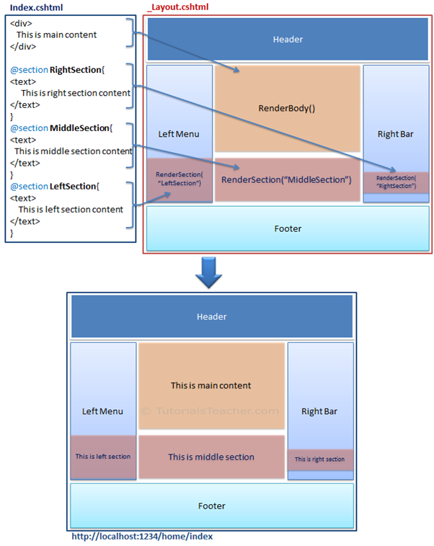

Slide 6
Layouts, RenderBody, RenderSection and RenderPage in ASP.NET MVC
Points to Remember
The Layout view contains common parts of a UI. It is same like masterpage of ASP.NET webforms.
_ViewStart.cshtml file can be used to specify path of layout page, which in turn will be applicable to all the views of the folder and its subfolder.
You can set the Layout property in the individual view also, to override default layout page setting of _ViewStart.cshtml
Layout view uses two rendering methods: RenderBody() and RenderSection().
RenderBody can be used only once in the layout view, whereas the RenderSection method can be called multiple time with different name.
RenderBody method renders all the content of view which is not wrapped in named section.
RenderSection method renders the content of a view which is wrapped in named section.
RenderSection can be configured as required or optional. If required, then all the child views must included that named section.

